Slide 1
Course : CSE 2201
Presentation Title
Bin Packing
Presented By
MAHDI BHUIYAN MD KAISARUL ISLAM
Roll : 1907015 Roll : 1907054
Department of Computer Science & Engineering
Khulna University of Engineering and Technology
Page No: 01

Slide 2
What is Bin Packing ?
The bin packing problem is an optimization problem, in which items of different sizes must be packed into a finite number of bins or containers, each of a fixed given capacity, in a way that minimizes the number of bins used.
Page No: 02

Slide 3
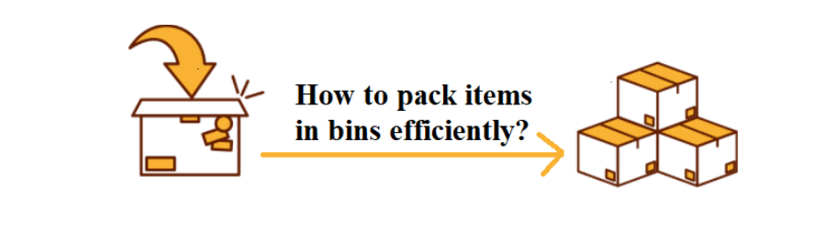
Bin Packing
Page No: 03

Slide 4
Bin Packing(cont’d)
Given n items with sizes s1, s2, ..., sn such that 0 ≤ si ≤ 1 for 1 ≤ i ≤ n, pack them into the fewest number of unit capacity bins.
Problem is NP-hard.
There is no known polynomial time algorithm for its solution.
Page No: 04

Slide 5
Bin packing Optimal Solution
Bin packing problem
1
…….
.5 .7 .5 .2 .4 .2 .5 .1 .6
Page No: 05

Slide 6
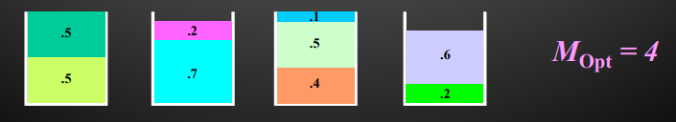
Bin packing Optimal Solution (cont’d)
Sum of Items :
.5 + .7 + .5 + .2 + .4 + .2 + .5 + .1 + .6 = 3.7
No of minimum bin needed :
Ceil ( 3.7 / 1 ) = 4 Mopt = 4
Page No: 06

Slide 7
Online bin packing :
Items arrive one by one. Each item must be assigned immediately to a bin, without knowledge of any future items. Reassignment is not allowed.
Offline bin packing :
All n items are known in advance, i.e. before they have to be packed.
Page No: 07

Slide 8
Next-Fit (NF) Algorithm
Check to see if the current item fits in the current bin.
If so, then place it there, otherwise start a new bin.
Page No: 08

Slide 9
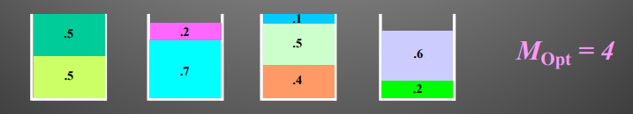
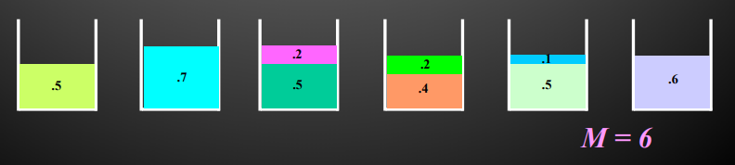
Next-Fit (NF) Algorithm (cont’d)
Bin Packing Problem
.5 .7 .5 .2 .4 .2 .5 .1 .6
Next Fit Packing Algorithm
Page No: 09

Slide 10
Next-Fit (NF) Algorithm (cont’d)
• Theorem: Let M be the number of bins required to pack a list I of items optimally. Next Fit will use at most 2M bins.
• Lower Bound: There exist sequences such that Next Fit uses 2M −2 bins, where M is the number of bins in an optimal solution.
Page No: 10

Slide 11
First Fit (FF) Algorithm
Scan the bins in order and place the new item in the first bin that is large enough to hold it.
A new bin is created only when an item does not fit in the previous bins.
Page No: 11

Slide 12
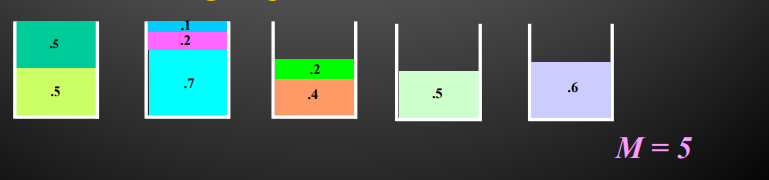
First Fit (FF) Algorithm Example
.5 .7 .5 .2 .4 .2 .5 .1 .6
Next Packing Problem
First Fit Packing Algorithm
Page No: 12

Slide 13
Running Time for First Fit
• Easily implemented in O(n2) time
• Can be implemented in O(n log n) time:
– Idea: Use a balanced search tree with height O(log n).
– Each node has three values: index of bin, remaining capacity of bin, and best (largest) in all the bins represented by the subtree rooted at the node.
– The ordering of the tree is by bin index.
Page No: 13

Slide 14
First-Fit (FF) Algorithm (cont’d)
• Theorem: Let M be the optimal number of bins required to pack a list I items. Then First Fit never uses more than 1.7M bins.
• Lower Bound: There exist sequences such that First Fit uses 1.67M bins.
Page No: 14

Slide 15
Best Fit (BF) Algorithm
New item is placed in a bin where it fits the tightest. If it does not fit in any bin, then start a new bin.
Can be implemented in O(n log n) time, by using a balanced binary tree storing bins ordered by remaining capacity.
Page No: 15

Slide 16
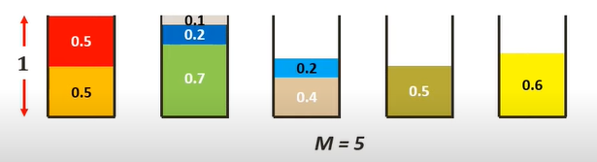
Best Fit (BF) Algorithm Example
.5 .7 .5 .2 .4 .2 .5 .1 .6
Page No: 16

Slide 17
Can BF(Best Fit) give us the OP(Optimal Packing) ?
Page No: 17

Slide 18
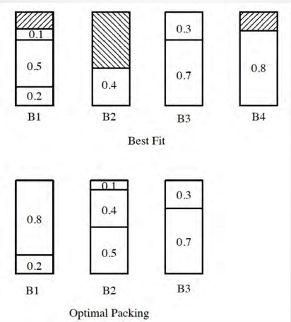
Best Fit (BF) Algorithm Example (cont’d)
• I = (0.2, 0.5, 0.4, 0.7, 0.1, 0.3, 0.8)
Page No: 18

Slide 19
Other Heuristics
Major problems with online algorithms is that it is hard to pack large items,especially when they occur late in the input.
In offline algorithms where we know the sizes of all items in advancd, a natural solution is to first sort items by size,from largest to smallest,and then apply the following heuristics
Page No: 19

Slide 20
Other Heuristics (cont’d)
• First Fit Decreasing (FFD): First order the items by size, from largest to smallest, then run the First Fit Algorithm.
• Best Fit Decreasing (BFD): First order the items by size, from largest to smallest, then run the Best Fit Algorithm.
Page No: 20

Slide 21
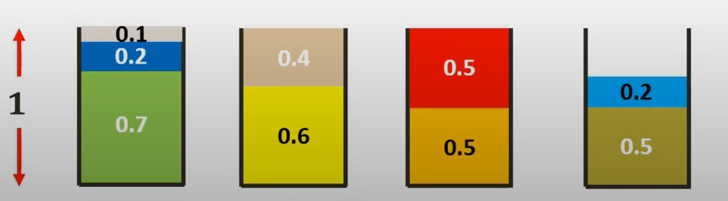
First Fit Decreasing (FFD):
I = .5 .7 .5 .2 .4 .2 .5 .1 .6
After Sorting in decreasing order
I = .7 .6 .5 .5 .5 .4 .2 .2 .1
Now apply First Fit Algorithm
Page No: 21

Slide 22
Best Fit Decreasing (BFD):
I = .5 .7 .5 .2 .4 .2 .5 .1 .6
After Sorting in decreasing order
I = .7 .6 .5 .5 .5 .4 .2 .2 .1
Now apply Best Fit Algorithm
Page No: 22

Slide 23
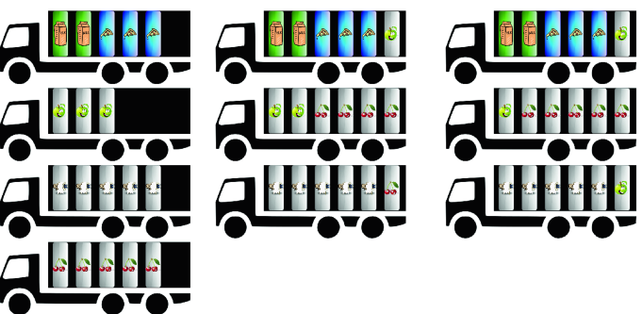
Real Life Example
Page No: 23

Slide 24
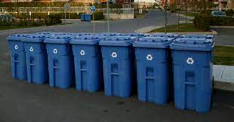
Real Life Example (cont’d)
Page No: 24

Slide 25

Historical Applications
• Mix tapes
Page No: 25

Slide 26
Thank You
Page No: 26

